Slide 1
Title: Human Stampede
Subtitle: Uncovering Patterns and insights from Tragic Events
Presented by: Dickson Muloma Chamwada.

Slide 2
Introduction
Dataset overview: The Human stampedes dataset records incidents of stampedes worldwide details on location, causes and fatalities.
Goals: To analyze the dataset to uncover patterns and gains insights into the causes and impacts of stampedes

Slide 3
Import Process and the interesting thing
I briefly followed the the correct modus operandi required to import the dataset on the MySQL workbench. I used various SQL queries like Order By, SELECT, FROM and COUNT. I also encountered a few challenges while importing the dataset on the MySQL work bench such as data type not matching and handling missing values.
The interesting fact I discovered is that India has the highest number of recorded stampedes often due to large public events.

Slide 4
Cool Facts
Fact 1: I have discovered that religious events have led to a significant number of fatalities with a total number of 2,788.
Fact 2: Average Number of Fatalities per Stampede
On average, each stampede results in approximately X fatalities

Slide 5
Discuss your question, SQL queries and What I have learned
Which countries experience the most stampedes during religious events?
SQL Query
SELECT Country, COUNT(*) as Number_of_Stampedes
FROM stampedes
WHERE Event_Type = 'Religious'
GROUP BY Country
ORDER BY Number_of_Stampedes DESC
LIMIT 5;
From the query I learned that Countries like India and Saudi Arabia frequently experience stampedes during large religious gatherings.

Slide 6
Question 2: What is the most common causes of stampedes in the dataset?
SQL Query
SELECT Cause, COUNT(*) as Frequency
FROM stampedes
GROUP BY Cause
ORDER BY Frequency DESC
LIMIT 1;
From the query I learned that The most common cause of stampedes is mass panic during emergencies.

Slide 7
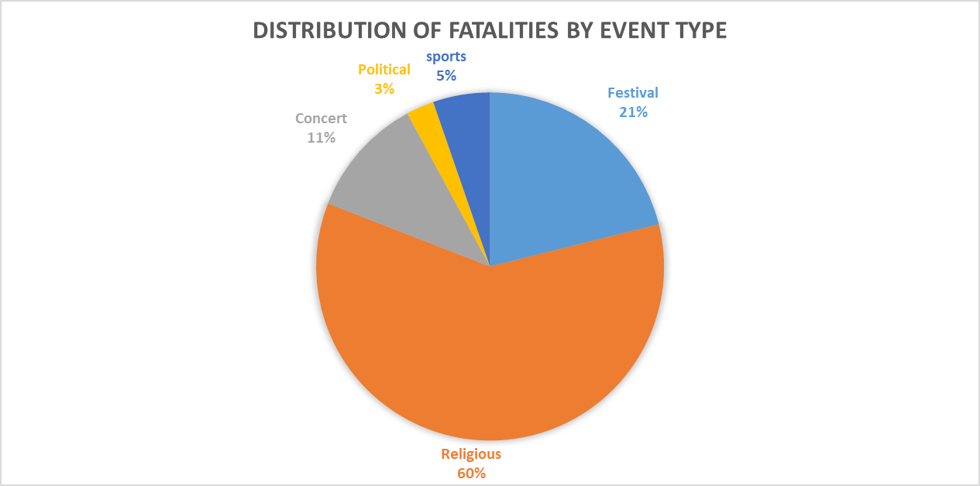
Presenting Charts; This pie chart shows the activities with the highest occurrences of stampedes, religious leading in the list.

Slide 8
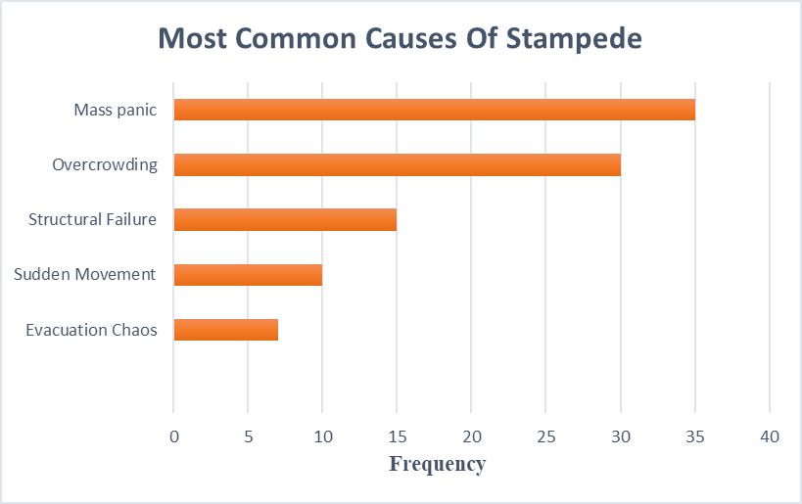
Bar chart; Most causes of Stampede. The below bar chart shows the most common cause of stampede mass panic being the leading cause

Slide 9
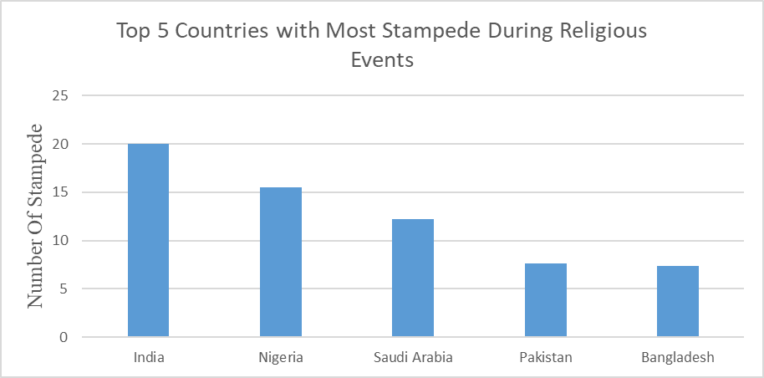
Bar Chart; shows the top countries with most stampede during religious activities.

Slide 10
Summary
The Human Stampedes dataset reveals critical insights into the frequency, causes, and impacts of stampedes worldwide.
Key Findings
India has the highest number of stampedes, often linked to large public events.
Average fatalities per stampede and significant years with high fatalities were identified.
Religious events and mass panic are major contexts and causes for stampedes.

